Slide 1
Multi-Modal Audio Processing with Domain-Specific RAG
Team Members: Divyansh Gupta
IFT 593: Applied Project
Professor: Dinesh Sthapit
January 2025

Slide 2
Project Concept
Technology Solution: A RAG-powered system that enhances multilingual audio dubbing by integrating contextual knowledge and accent preservation.
Stakeholders: Project Sponsor, Developer, Technical Consultants, End Users (Students, Researchers, Corporate Teams)
Development Tools: Python (Flask, FastAPI), GPT-4o API, StreamLit UI, SQLite, Vector Database(ChromaDB)

Slide 3
Accomplishments
1. Successfully integrated RAG pipeline with GPT-4o API.
2. Developed UI for audio upload, language/accent selection.
3. Established development environment and started coding.
Build vs. Design: Minor changes in UI layout based on usability testing.

Slide 4
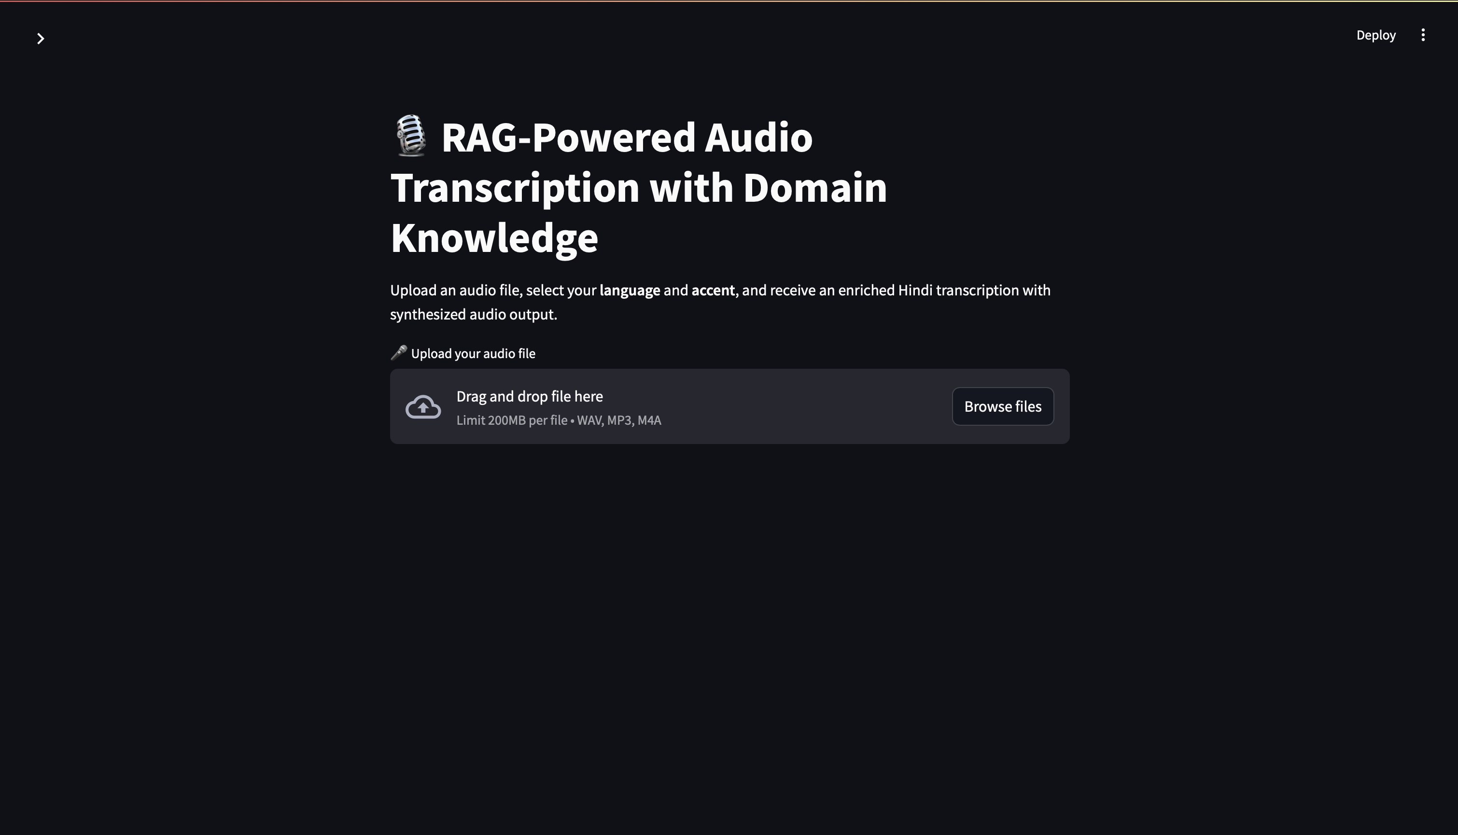
Screenshots

Slide 5
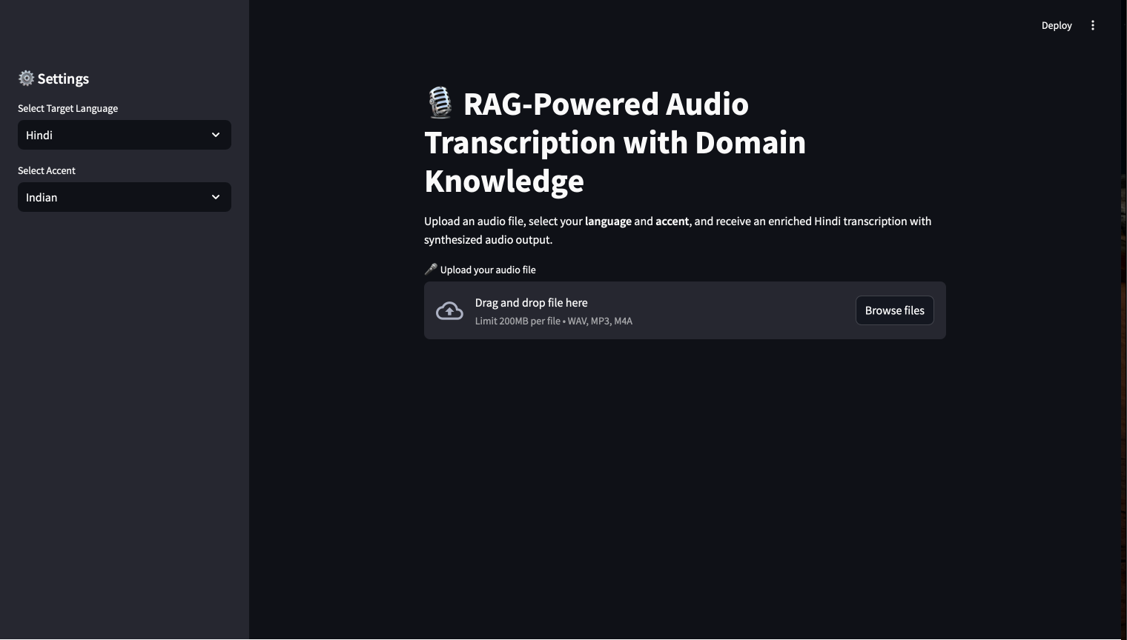
Screenshots

Slide 6
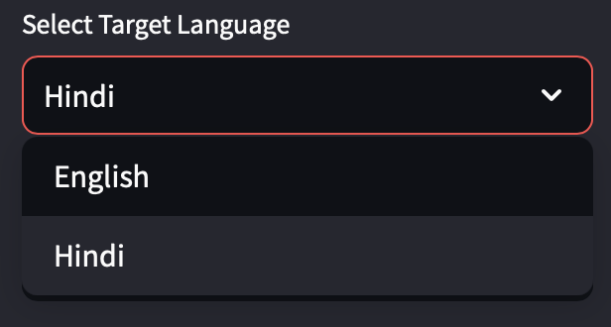
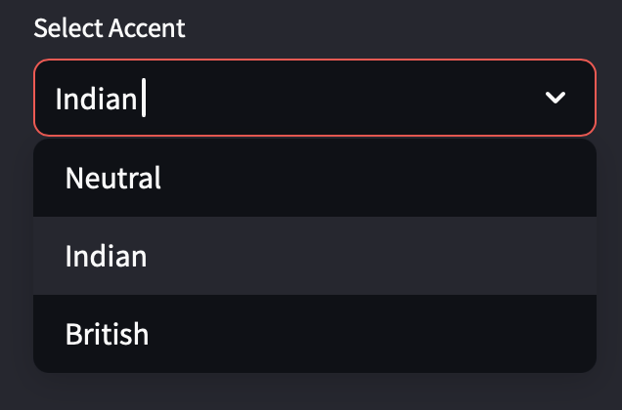
Screenshots

Slide 7
Screenshots

Slide 8
Screenshots

Slide 9
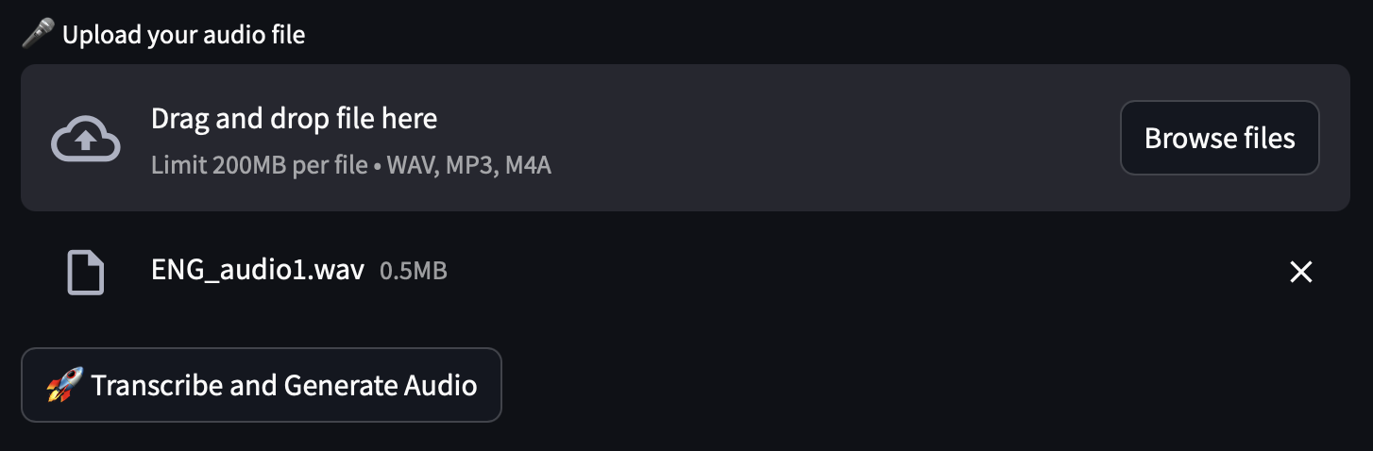
Screenshots

Slide 10
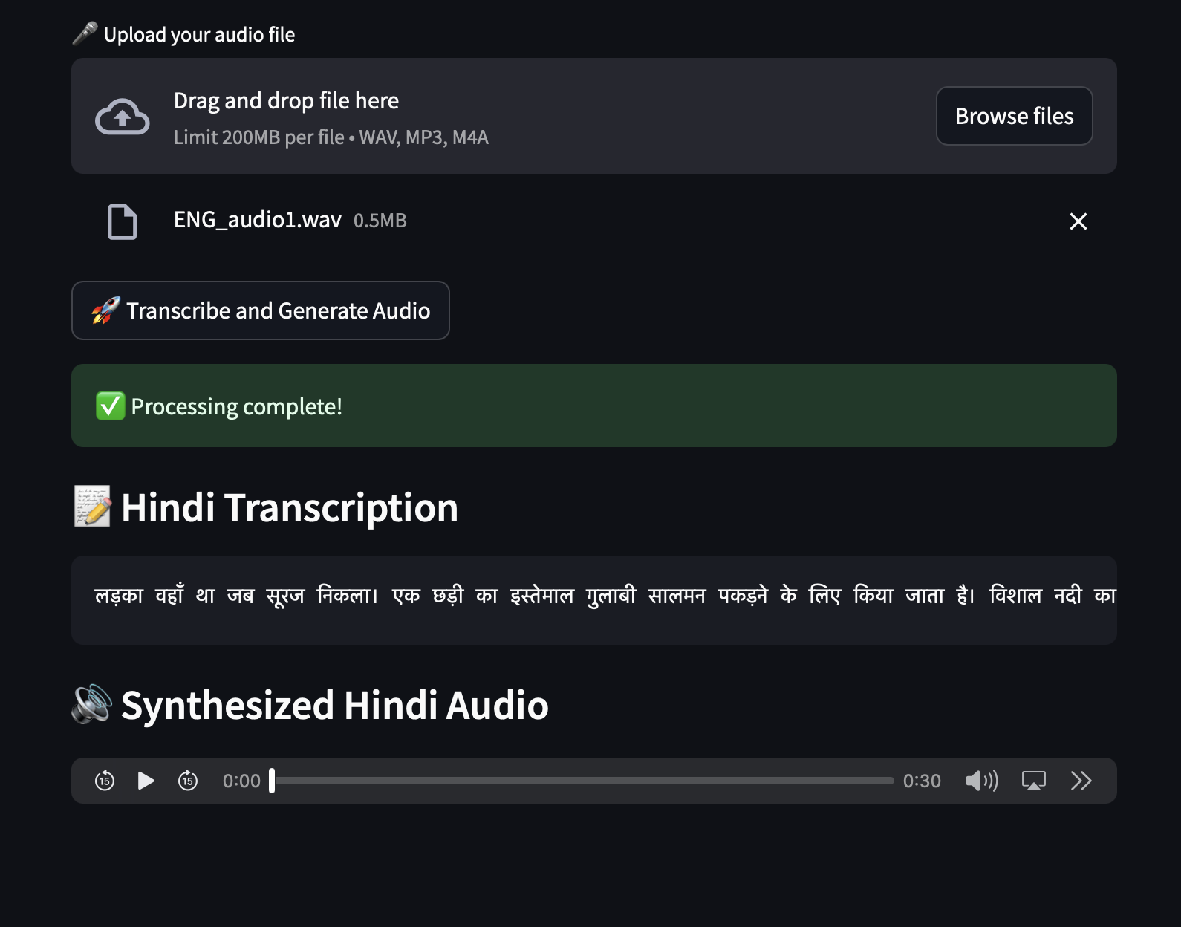
Screenshots

Slide 11
Problems & Solutions
1. Latency Issues: Optimizing prompt engineering and caching responses.
2. Accent Preservation Challenges: Fine-tuning GPT-4o prompt structure for better control.
3. API Constraints: Implementing fallback mechanisms for API rate limits.
Future Plan: Further optimization of retrieval augmentation and improved UI responsiveness.

Slide 12
Schedule - Next Steps
1. Implement additional authentication features for secure access.
2. Expand support for additional languages and accents.
3. Improve response time by optimizing vector database retrieval.
4. Conduct extensive testing and user feedback collection.
5. Finalize UI and documentation for project completion.

